Slide 1
PIZZA SALES PROJECT

Slide 2
ABOUT MYSELF
Hello everyone
My name is KANIKA BHATT.
In this project I had utilize SQL queries to solve the questions that were related to PIZZA SALES

Slide 3
Here in this project I had used MySql database. MySQL is a widely-used open-source relational database management system (RDBMS) that is renowned for its speed, reliability, and ease of use.

Slide 4
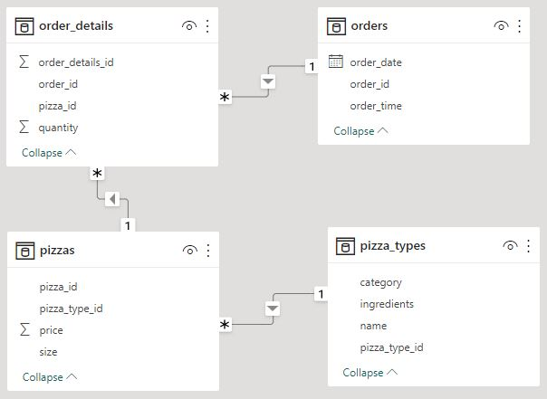
Schema of PIZZA SALES
Established relationships between tables using primary keys and foreign keys

Slide 5
Questions
Basic:
Retrieve the total number of orders placed.
Calculate the total revenue generated from pizza sales.
Identify the most common pizza size ordered.
List the top 5 most ordered pizza types along with their quantities.
Intermediate:
Join the necessary tables to find the total quantity of each pizza category ordered.
Determine the distribution of orders by hour of the day.
Join relevant tables to find the category-wise distribution of pizzas.
Group the orders by date and calculate the average number of pizzas ordered per day.
Determine the top 3 most ordered pizza types based on revenue.
Advanced:
Calculate the percentage contribution of each pizza type to total revenue.
Analyze the cumulative revenue generated over time.
Determine the top 3 most ordered pizza types based on revenue for each pizza category.

Slide 6
SQL queries to retrieve specific data

Slide 7


Retrieve the total number of orders placed

Slide 8
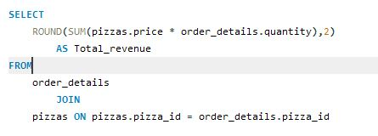

Calculate the total revenue generated from pizza sales

Slide 9
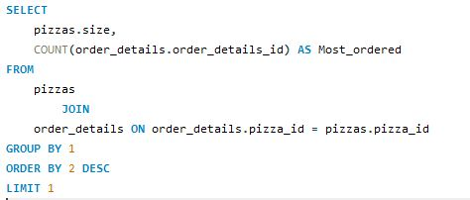

Identify the most common pizza size ordered

Slide 10
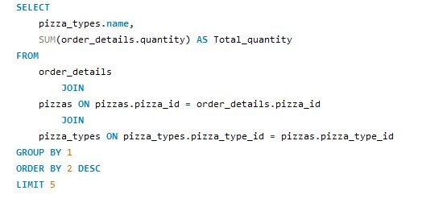
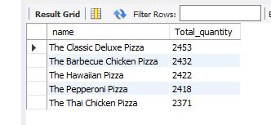
List the top 5 most ordered pizza types along with their quantities

Slide 11
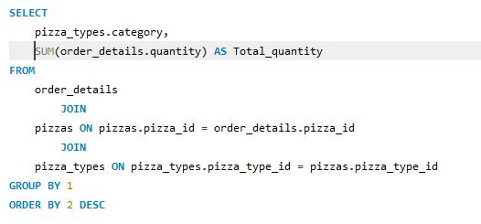
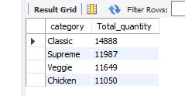
Join the necessary tables to find the total quantity of each pizza category ordered

Slide 12
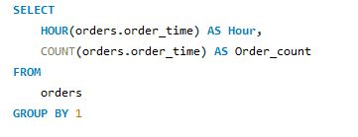
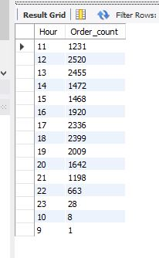
Determine the distribution of orders by hour of the day

Slide 13
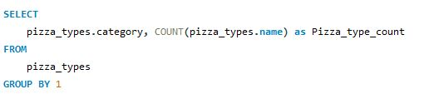
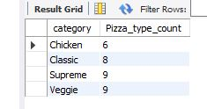
Join relevant tables to find the category-wise distribution of pizzas

Slide 14
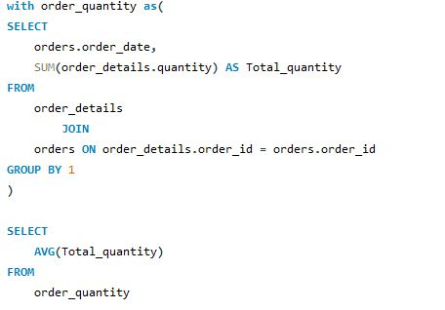

Group the orders by date and calculate the average number of pizzas ordered per day

Slide 15
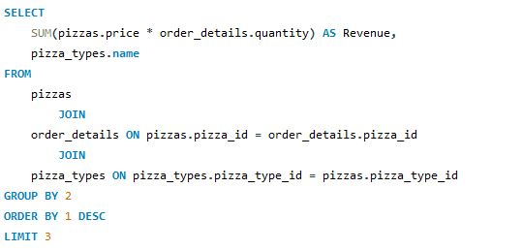
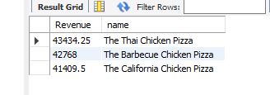
Determine the top 3 most ordered pizza types based on revenue

Slide 16
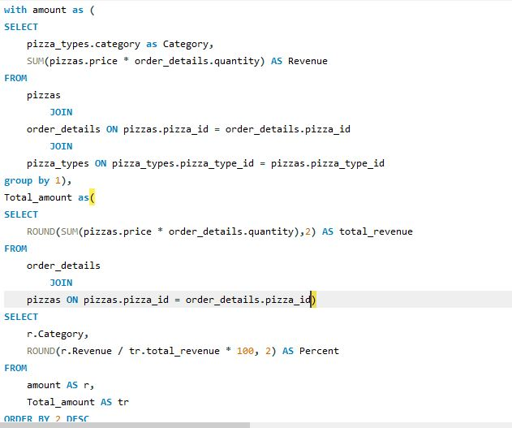
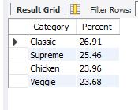
Calculate the percentage contribution of each pizza type to total revenue

Slide 17
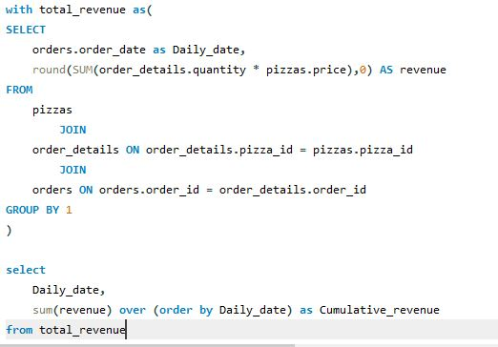
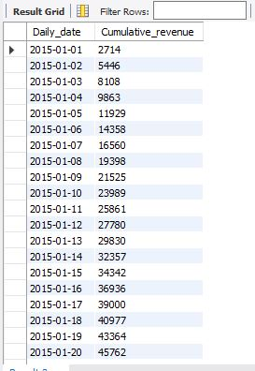
Analyze the cumulative revenue generated over time

Slide 18
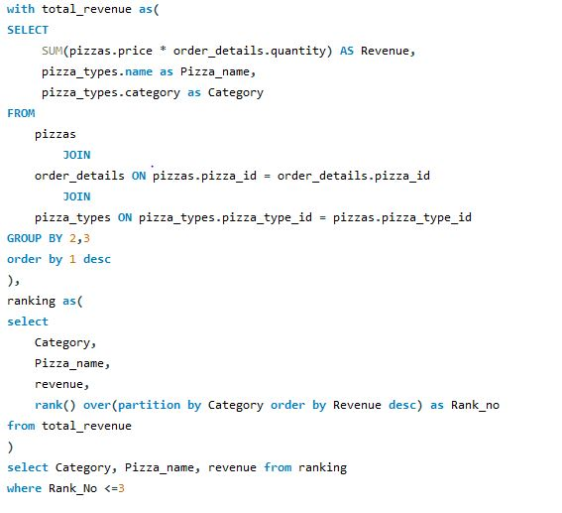
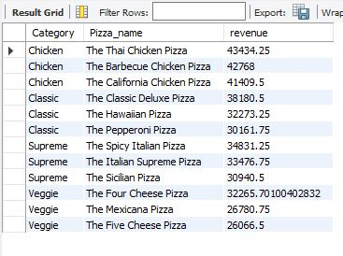
Determine the top 3 most ordered pizza types based on revenue for each pizza category

Slide 19
By leveraging MySQL’s capabilities for data storage, retrieval and management, the pizza sales project aims to streamline operations, enhance customer service, and improve decision-making through detailed analytics

Slide 20
INSIGHTS
The highest percentage contribution to the Total Revenue is made by the Classic Pizza type and the mark obtained is of 26.91%.
The most ordered Pizza based on revenue is THE THAI CHICKEN PIZZA.
After analysing the orders on hourly basis it is concluded that majorly the Pizzas were ordered in afternoon between 12-2 PM and in evening between 5-7 PM
The most commonly ordered Pizza size is Large.
On analysing the Pizza sales I can say that it is highly profitable business as the Total revenue generated is $817860
High marketing strategies should be adopted for the Classic Pizza type as it as major contribution to revenue and loved by people.

Slide 21
THANK YOU

